Slide 1

13924 - Table Management System
I2P(II) Final Practice

Slide 2
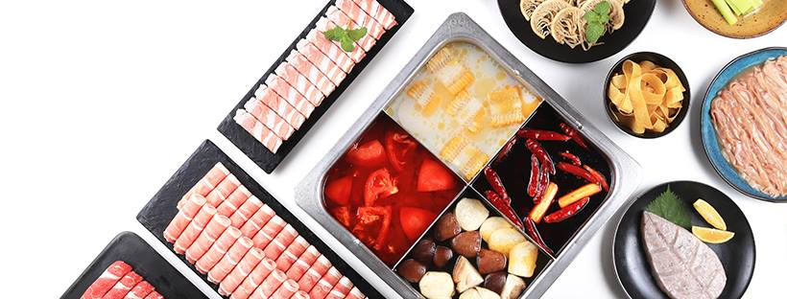
Description
Hodilo (海底撈?) is a well-known hot pot (火鍋) restaurant, and it's extremely challenging to have a table during peak dining hours.
Even though, the restaurant does not accept reservations in advance, requiring every guest to visit the restaurant, take a number, and wait for their turn.
Hodilo is opening a new branch in Hsinchu, and you have been invited to design a queuing system, which helps assign a table to each group of guests.

Slide 3


Description
Design a table management system for the restaurant.
Given information including:
Arrival record of each guest
Number of the tables for each size
Arrival Time
Group Size
Dining Duration
Tables for 4 ×20
Tables for 6 ×20
…
Assign a table to each guest, and
provide an estimated waiting time for their table.

Slide 4
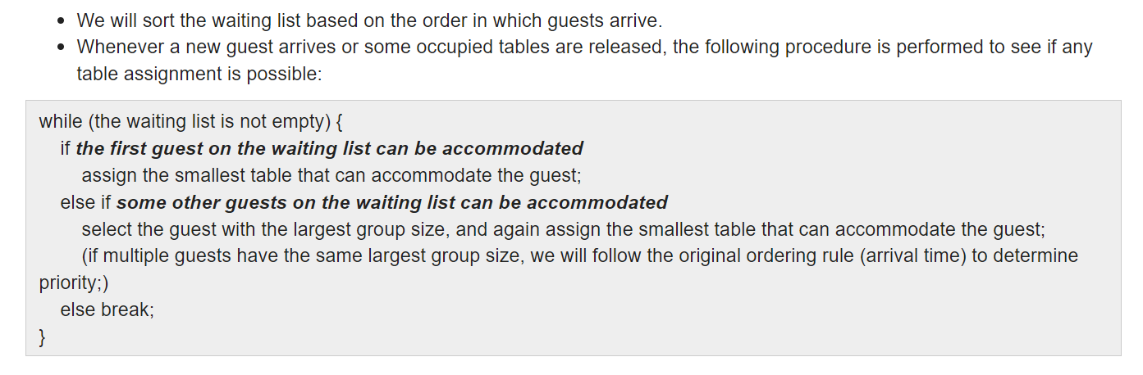
Description
Each guest's arrival time is unique. We will add them to the waiting list one by one and subsequently assign tables to the guests on the waiting list.
Here's how we assign guests from the waiting list to tables:

Slide 5
Description
Waiting List
When a guest arrives, add them to the list
Arrival
Time
Group
Size
Dining
Duration
#1
780
5
50
#2
820
2
40
#3
850
3
45

Slide 6
Description
Waiting List
When a guest arrives, add them to the list
Arrival
Time
Group
Size
Dining
Duration
Whenever a new guest arrives or some occupied tables are released,
#1
780
5
50
#2
820
2
40
The 1st guest on the waiting list can be accommodated.
Assign the smallest table to them!
#3
850
3
45
Some other guests on the waiting list can be accommodated
then, select the guest with the largest group size
Assign the smallest table to them!

Slide 7
Description
Waiting List
When a guest arrives, add them to the list
Arrival
Time
Group
Size
Dining
Duration
Whenever a new guest arrives or some occupied tables are released,
#1
780
5
50
#2
820
2
40
The 1st guest on the waiting list can be accommodated.
Assign the smallest table to them!
#3
850
3
45
Some other guests on the waiting list can be accommodated
then, select the guest with the largest group size
Assign the smallest table to them!

Slide 8
Sample I/O
Current Time
arrival timestamp | group size | dining duration | answer
0
6 2
780 1 75
820 2 40
830 3 30
840 4 100
845 1 60
850 2 65
2 1
4 2
Available
Available
Available

Slide 9
Sample I/O
Current Time
arrival timestamp | group size | dining duration | answer
780 | 1 | 75 | 780
780
6 2
780 1 75
820 2 40
830 3 30
840 4 100
845 1 60
850 2 65
2 1
4 2
Add to waiting list
Available
Available
Available

Slide 10
Sample I/O
Current Time
arrival timestamp | group size | dining duration | answer
780 | 1 | 75 | 780
780
Assigning the smallest table
6 2
780 1 75
820 2 40
830 3 30
840 4 100
845 1 60
850 2 65
2 1
4 2
Available
Available
780~855

Slide 11
Sample I/O
Current Time
arrival timestamp | group size | dining duration | answer
780 | 1 | 75 | 780
820 | 2 | 40
820
6 2
780 1 75
820 2 40
830 3 30
840 4 100
845 1 60
850 2 65
2 1
4 2
Available
Add to waiting list
Available
780~855

Slide 12
Sample I/O
Current Time
arrival timestamp | group size | dining duration | answer
780 | 1 | 75 | 780
820 | 2 | 40 | 820
820
6 2
780 1 75
820 2 40
830 3 30
840 4 100
845 1 60
850 2 65
2 1
4 2
Available
820~860
780~855

Slide 13
Sample I/O
Current Time
arrival timestamp | group size | dining duration | answer
780 | 1 | 75 | 780
820 | 2 | 40 | 820
830 | 3 | 30
830
6 2
780 1 75
820 2 40
830 3 30
840 4 100
845 1 60
850 2 65
2 1
4 2
Available
Add to waiting list
820~860
780~855

Slide 14
Sample I/O
Current Time
arrival timestamp | group size | dining duration | answer
780 | 1 | 75 | 780
820 | 2 | 40 | 820
830 | 3 | 30 | 830
830
6 2
780 1 75
820 2 40
830 3 30
840 4 100
845 1 60
850 2 65
2 1
4 2
830~860
820~860
780~855

Slide 15
Sample I/O
Current Time
arrival timestamp | group size | dining duration | answer
780 | 1 | 75 | 780
820 | 2 | 40 | 820
830 | 3 | 30 | 830
840 | 4 | 100
840
No available table
6 2
780 1 75
820 2 40
830 3 30
840 4 100
845 1 60
850 2 65
2 1
4 2
830~860
Add to waiting list
820~860
780~855

Slide 16
Sample I/O
Current Time
arrival timestamp | group size | dining duration | answer
780 | 1 | 75 | 780
820 | 2 | 40 | 820
830 | 3 | 30 | 830
840 | 4 | 100
845 | 1 | 60
845
No available table
6 2
780 1 75
820 2 40
830 3 30
840 4 100
845 1 60
850 2 65
2 1
4 2
830~860
Add to waiting list
820~860
780~855

Slide 17
Sample I/O
Current Time
arrival timestamp | group size | dining duration | answer
780 | 1 | 75 | 780
820 | 2 | 40 | 820
830 | 3 | 30 | 830
840 | 4 | 100
845 | 1 | 60
850 | 2 | 65
850
No available table
6 2
780 1 75
820 2 40
830 3 30
840 4 100
845 1 60
850 2 65
2 1
4 2
830~860
Add to waiting list
820~860
780~855

Slide 18
Sample I/O
Current Time
arrival timestamp | group size | dining duration | answer
780 | 1 | 75 | 780
820 | 2 | 40 | 820
830 | 3 | 30 | 830
840 | 4 | 100
845 | 1 | 60
850 | 2 | 65
855
6 2
780 1 75
820 2 40
830 3 30
840 4 100
845 1 60
850 2 65
2 1
4 2
830~860
820~860
780~855

Slide 19
Sample I/O
Current Time
arrival timestamp | group size | dining duration | answer
780 | 1 | 75 | 780
820 | 2 | 40 | 820
830 | 3 | 30 | 830
840 | 4 | 100
845 | 1 | 60
850 | 2 | 65
855
6 2
780 1 75
820 2 40
830 3 30
840 4 100
845 1 60
850 2 65
2 1
4 2
830~860
820~860
Available

Slide 20
Sample I/O
Current Time
arrival timestamp | group size | dining duration | answer
780 | 1 | 75 | 780
820 | 2 | 40 | 820
830 | 3 | 30 | 830
840 | 4 | 100
845 | 1 | 60
850 | 2 | 65 | 855
855
Select the guest
with the largest group size
6 2
780 1 75
820 2 40
830 3 30
840 4 100
845 1 60
850 2 65
2 1
4 2
830~860
820~860
855~920

Slide 21
Sample I/O
Current Time
arrival timestamp | group size | dining duration | answer
780 | 1 | 75 | 780
820 | 2 | 40 | 820
830 | 3 | 30 | 830
840 | 4 | 100
845 | 1 | 60
850 | 2 | 65 | 855
860
6 2
780 1 75
820 2 40
830 3 30
840 4 100
845 1 60
850 2 65
2 1
4 2
830~860
820~860
855~920

Slide 22
Sample I/O
Current Time
arrival timestamp | group size | dining duration | answer
780 | 1 | 75 | 780
820 | 2 | 40 | 820
830 | 3 | 30 | 830
840 | 4 | 100
845 | 1 | 60
850 | 2 | 65 | 855
860
Tables may be released
at the same time!
6 2
780 1 75
820 2 40
830 3 30
840 4 100
845 1 60
850 2 65
2 1
4 2
Available
Available
855~920

Slide 23
Sample I/O
Current Time
arrival timestamp | group size | dining duration | answer
780 | 1 | 75 | 780
820 | 2 | 40 | 820
830 | 3 | 30 | 830
840 | 4 | 100 | 860
845 | 1 | 60 | 860
850 | 2 | 65 | 855
860
6 2
780 1 75
820 2 40
830 3 30
840 4 100
845 1 60
850 2 65
2 1
4 2
860~960
860~920
855~920

Slide 24
Idea
Maintain the Waiting List
Maintain the Table Status
Release & Assign the Table
Solving the Problem

Slide 25
Idea: Maintain the Waiting List
Using structure to store a guest's info, and
std::set to implement the waiting list
struct Guest {
int id;
int arrival;
int group;
int duration;
};
set<Guest> waiting_list;
// May Compile Error

Slide 26
Idea: Maintain the Waiting List
std::set with custom comparator
Reference↗︎
Approach 1
Functor
struct cmp {
bool operator() (Guest a, Guest b) const {
return a.arrival < b.arrival;
}
};
// sort by arrival time
set<Guest, cmp> waiting_list;

Slide 27
Idea: Maintain the Waiting List
std::set with custom comparator
Reference↗︎
Approach 2
Lambda Function (C++11)
auto cmp = [](Guest a, Guest b) {
return a.arrival < b.arrival;
};
// sort by arrival time
set<Guest, decltype(cmp)> waiting_list(cmp);

Slide 28
Idea: Maintain the Waiting List
std::set with custom comparator
Reference↗︎
Approach 3
Lambda Function (C++20)
auto cmp = [](Guest a, Guest b) {
return a.arrival < b.arrival;
};
// sort by arrival time
set<Guest, decltype(cmp)> waiting_list;

Slide 29
Idea: Maintain the Waiting List
How can we select the 1st guest on the list?
// sort by arrival time
set<Guest, decltype(cmp)> waiting_list(cmp);
// 1st guest on the list
Guest guest = *waiting_list.begin();

Slide 30
Idea: Maintain the Waiting List
When the 1st guest can't be accommodated,
how can we select the guest with the largest group size?
Is one set not sufficient? Use two sets instead!

Slide 31
Idea: Maintain the Waiting List
auto cmp_arrival = [](Guest a, Guest b) {
return a.arrival < b.arrival;
};
auto cmp_group = [](Guest a, Guest b) {
return a.group == b.group ? a.arrival > b.arrival : a.group < b.group;
};
// sort by arrival time
set<Guest, decltype(cmp_arrival)> waiting_arrival(cmp_arrival);
// sort by group size (small to large) -> arrival time (late -> early)
set<Guest, decltype(cmp_group)> waiting_group(cmp_group);

Slide 32
Idea: Maintain the Waiting List
// sort by group size (small to large) -> arrival time (late -> early)
set<Guest, decltype(cmp_group)> waiting_group(cmp_group);
auto it = waiting_group.upper_bound(Guest{0, 0, largest_size, 0});
if (it != waiting_group.begin())
Guest guest = *(--it);
Upper Bound↗︎
Returns an iterator pointing to the first element
that is greater than key.

Slide 33
Idea: Maintain the Waiting List
Upper Bound↗︎
Find the first element that is greater than key.
Suppose key = 6, to find the first element which’s greater than 6
element greater than 6
1 2 4 4 6 6 6 8 9 11 13 14
int x = *set.upper_bound(6); // x = 8

Slide 34
Idea: Maintain the Waiting List
To find the guest with the largest group size and the earliest arrival time.
(suppose largest available table size is 3)
auto it = waiting_group.upper_bound(Guest{0, 0, 3, 0});
The guest we should choose
it
group size
3
group size
2
group size
2
group size
3
group size
3
group size
4
arrival time
0
arrival time
20
arrival time
5
arrival time
15
arrival time
0
arrival time
25
upper bound key
sort by group size (small -> large) -> arrival time (later -> earlier)

Slide 35
Idea
Maintain the Waiting List
Maintain the Table Status
Release & Assign the Table
Solving the Problem

Slide 36
Idea: Maintain the Table Status
Keep track of the available tables and the tables currently in use.
Available Tables
map<int, int> table_avl; // {table size: number of tables}
Tables in use
multiset<pair<int, int>> table_use; // {release time, table size}
priority_queue<pair<int, int>> table_use; // alternative
Priority Queue↗︎

Slide 37
Idea: Maintain the Table Status
Available Tables
map<int, int> table_avl; // {table size: number of tables}
To find the size of the largest available table
int largest_size = (*--table_avl.end()).first;
int largest_size = (*table_avl.rbegin()).first;
Reverse Iterator↗︎
rend()
rbegin()
begin()
end()

Slide 38
Idea: Maintain the Table Status
Available Tables
map<int, int> table_avl; // {table size: number of tables}
To find the smallest table that can accommodate a guest
auto table = table_avl.lower_bound(guest.group);
// iterator of pair element
Lower Bound↗︎
Returns an iterator pointing to the first element
that is not less than (i.e. greater or equal to) key.

Slide 39
Idea: Maintain the Table Status
Tables in use
multiset<pair<int, int>> table_use; // {release time, table size}
Simply insert the pair of a table's release time and size into the multiset
Since there might be simultaneous releases of two tables
with the same size, we need to use a multiset instead of a set.

Slide 40
Idea
Maintain the Waiting List
Maintain the Table Status
Release & Assign the Table
Solving the Problem

Slide 41
Idea: Release & Assign the Table
assignTable()
Do the table assignment procedure at the moment of “time”
bool assignTable(int time) {
// no table or no one is waiting
if (table_avl.empty() || waiting_arrival.empty()) return false;
// table (iterator) and guest are about to be assigned
Guest guest = *waiting_arrival.begin();
auto table = table_avl.lower_bound(guest.group); // to find the smallest table that can accommodate the guest
...

Slide 42
Idea: Release & Assign the Table
assignTable()
Do the table assignment procedure at the moment of “time”
bool assignTable(int time) {
...
if (table == table_avl.end()) { // no such table
int largest_size = (*table_avl.rbegin()).first; // largest table size
// to find the largest-sized guest that can be accommodated
auto it = waiting_group.upper_bound(Guest{0, 0, largest_size, 0});
if (it == waiting_group.begin()) return false;
guest = *(--it);
// to find the smallest table that can accommodate the guest
table = table_avl.lower_bound(guest.group);
}
...

Slide 43
Idea: Release & Assign the Table
assignTable()
Do the table assignment procedure at the moment of “time”
bool assignTable(int time) {
...
// handle table availability
int table_size = table->first;
table_avl[table_size]--;
if (!table_avl[table_size]) table_avl.erase(table_size);
table_use.insert({time+guest.duration, table_size});
// record the answer and remove guest from the list
ans[guest.id] = time;
waiting_arrival.erase(guest); waiting_group.erase(guest);
return true;
}

Slide 44
Idea: Release & Assign the Table
releaseTable()
Release all the tables before the moment of “time”
void releaseTable(int time) {
while (table_use.size() && (*table_use.begin()).first <= time) {
int release_time = (*table_use.begin()).first;
table_avl[(*table_use.begin()).second]++;
table_use.erase(table_use.begin());
// table release simultaneously
if (table_use.size() && ((*table_use.begin()).first) == release_time) continue;
// table release simultaneously
// attempt to assign table
while (assignTable(release_time));
}
}

Slide 45
Idea
Maintain the Waiting List
Maintain the Table Status
Release & Assign the Table
Solving the Problem

Slide 46
Idea: Now we have…
Waiting list (sort by…)
arrival time
group size
waiting_arrival
waiting_group
Table
Available tables
Tables in use
table_avl
table_use
Procedures
assignTable()
releaseTable()

Slide 47
Idea: Solving the Problem
1st guest arrival
2nd guest arrival
nth guest arrival
…
Release the table before the next guest arrives.
Next guest has not yet arrived.
Add the arrived guest to the waiting list.
Next guest has arrived.
Attempt to assign the table to the guest on the list.

Slide 48
Idea: Solving the Problem
main()
Guest arr[N];
for (int i=0; i<n; i++) {
// clear and assign table before i-th arrival
releaseTable(arr[i].arrival-1);
// add to waiting list
waiting_arrival.insert(arr[i]); waiting_group.insert(arr[i]);
// clear all the table and try to assign table on i-th arrival
releaseTable(arr[i].arrival); assignTable(arr[i].arrival);
}
// clear all the remaining table
if (waiting_arrival.size()) releaseTable(1e9);

Slide 49

Good Luck!
Let's become more familiar with these
commonly used STLs through this problem!
I feel hungry again!!
Happy Summer Holidays~

